Slide 1
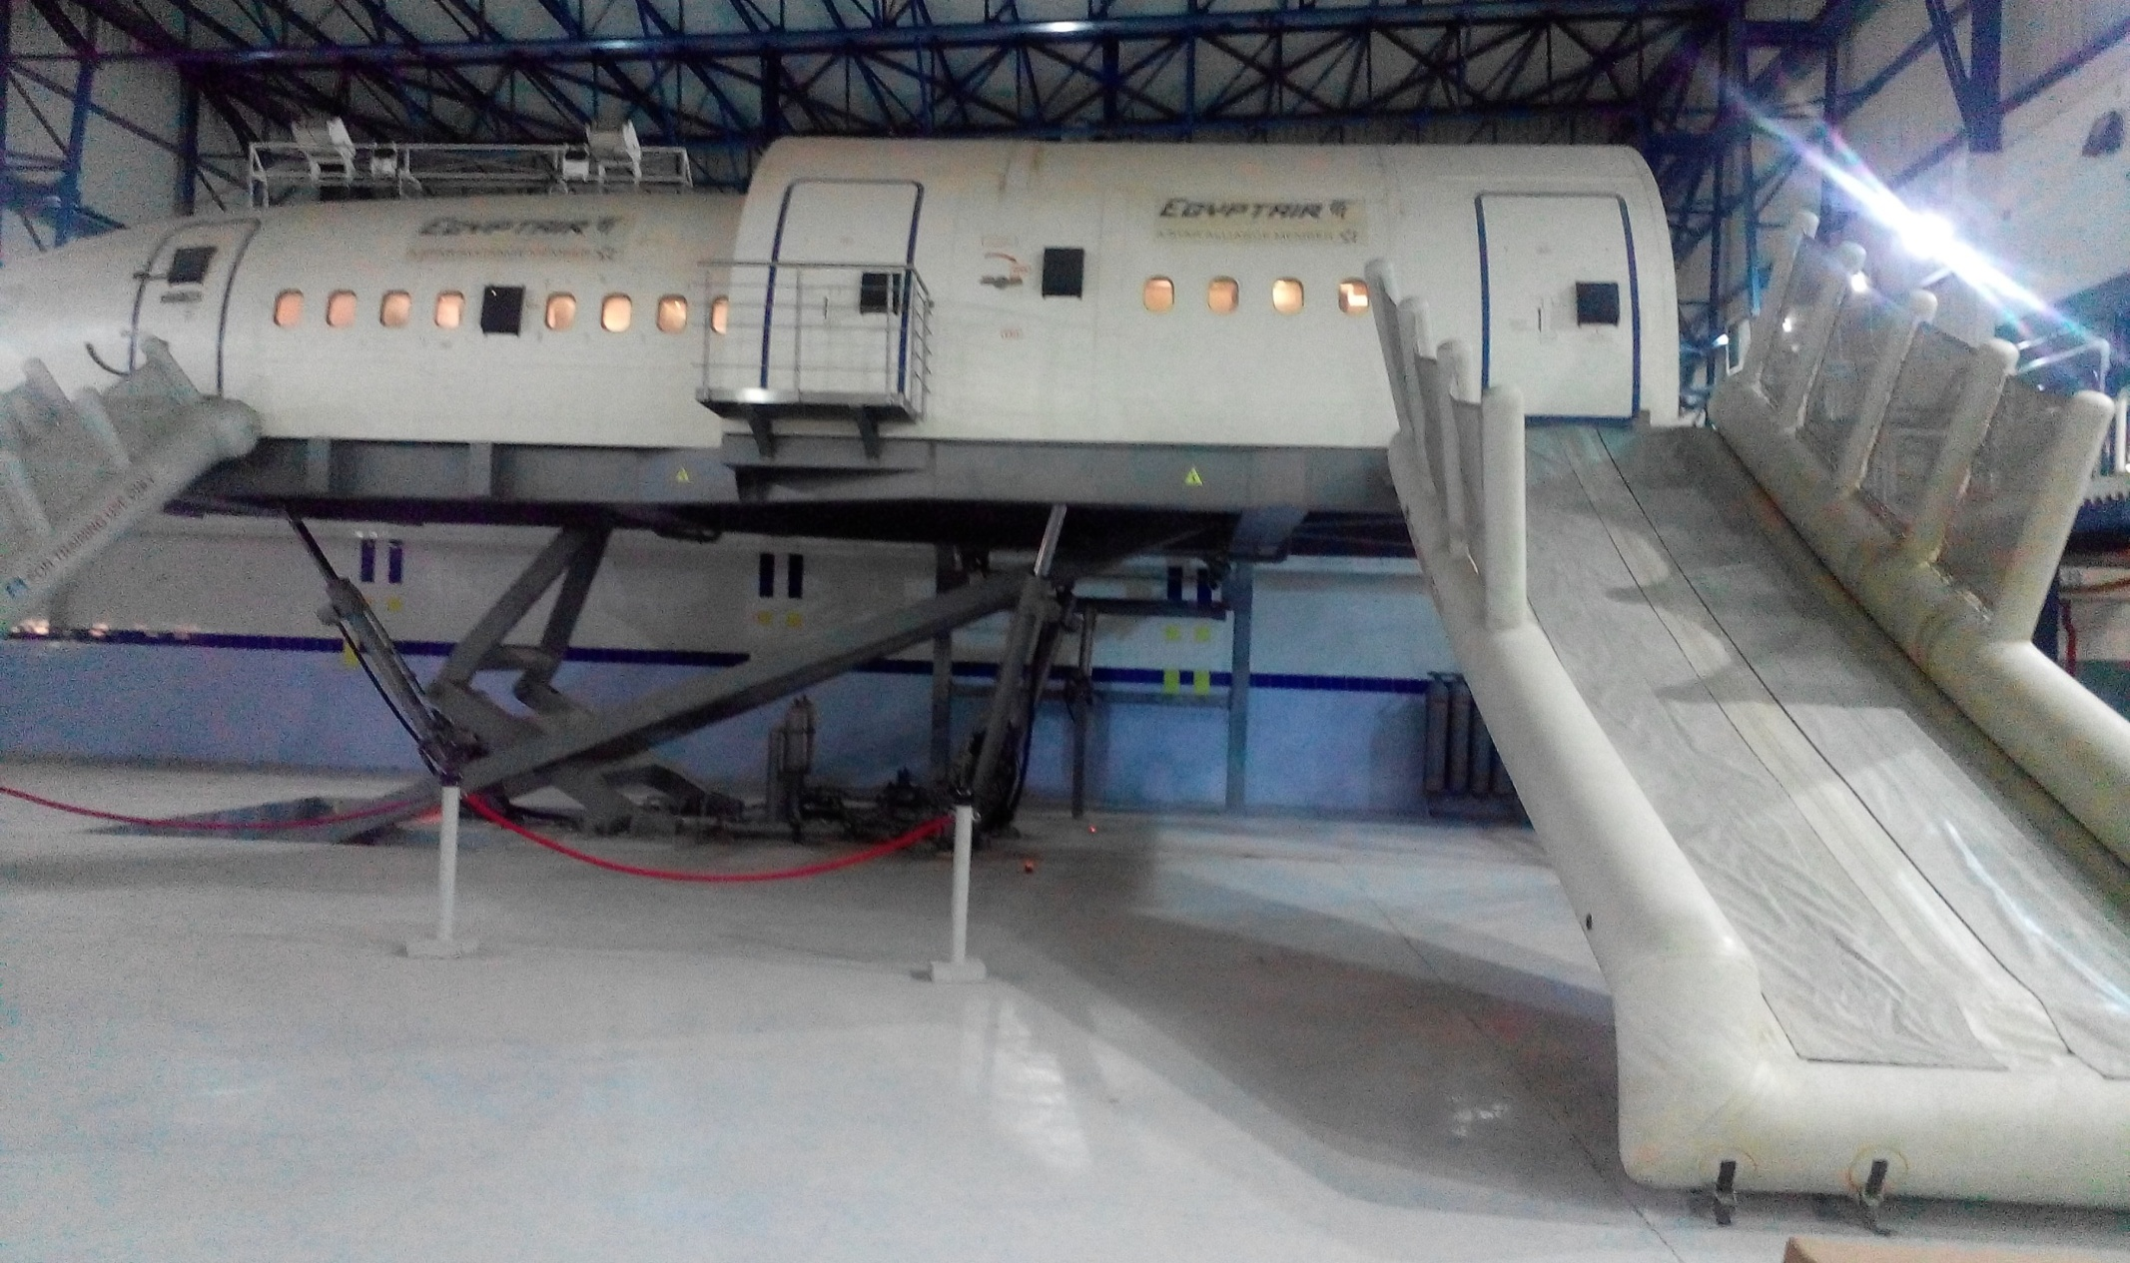
CEET
Cabin Emergency Evacuation Trainer
Prepared By: Mohamed Sakr

Slide 2

Objective
Upon completion of this show, each one should familiar to CEET Cabin Simulator and will be able to know :-
- What is CEET .
- Who need CEET for training .
- Main purpose of training .

Slide 3

What is CEET ?
- Cabin Emergency Evacuation Trainer .
- EVAC can be done in land by using Slide Chute .
- EVAC can also be done in water by using Raft .
- Additional malfunction scenarios can be done
like Simulated Fire Fighting , Door lock …etc .

Slide 4
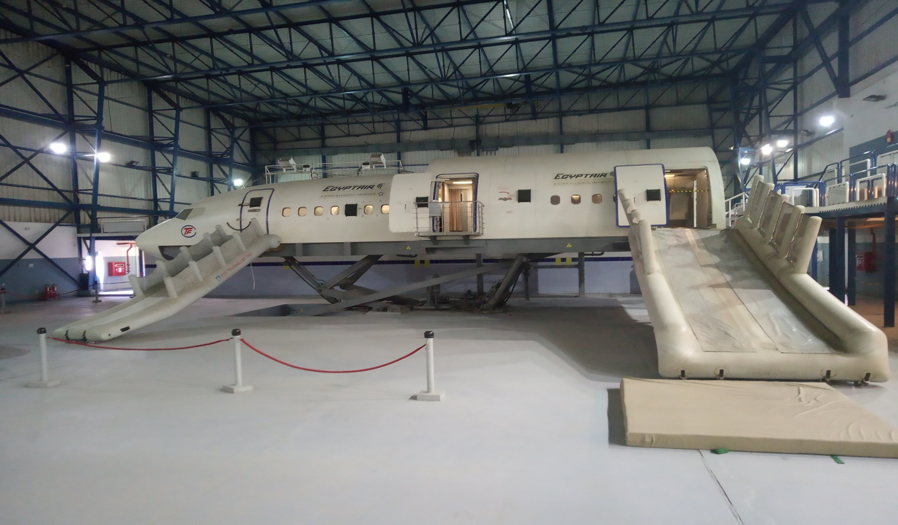
EVAC in Land using Slide Chute

Slide 5
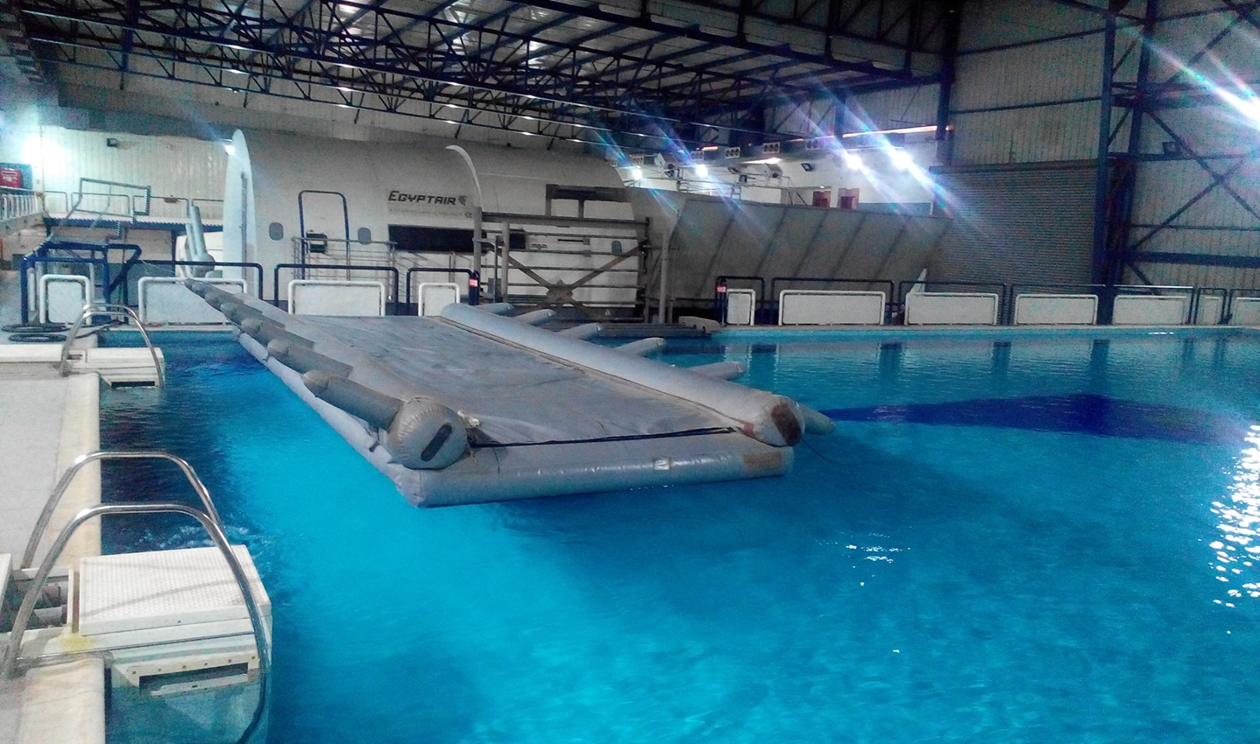
EVAC in Water using Slide Raft

Slide 6
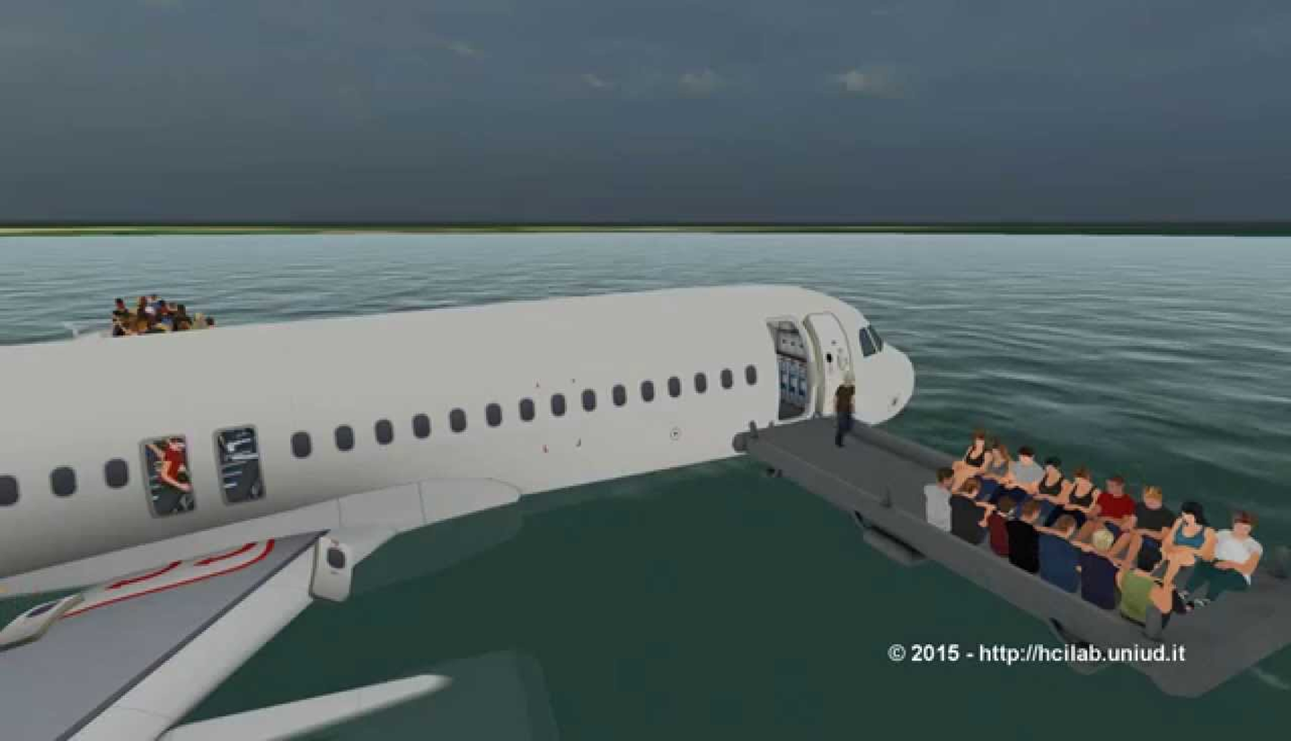
EVAC in Water using Slide Raft

Slide 7
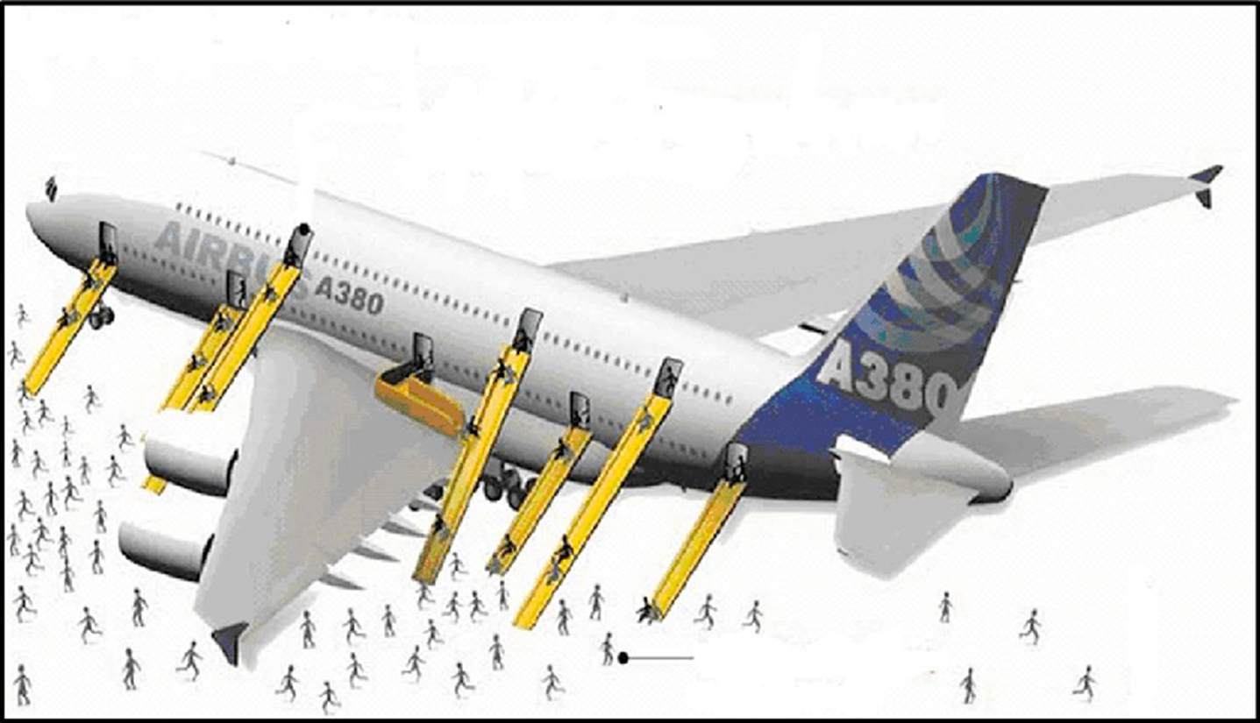
EVAC Location

Slide 8

Who need CEET for training ?
Training essential to Flight Crew for most of emergency cases in Aircraft .

Slide 9

Main Purpose of Training
Increase Efficiency
Improve Skills
Accurate Decision
Quick Action
Knowledge of Emergency Cases

Slide 10
Main Area of CEET
CEET structure design
IOS (Instructor Operation station)
Computer Room
Motion Room

Slide 11
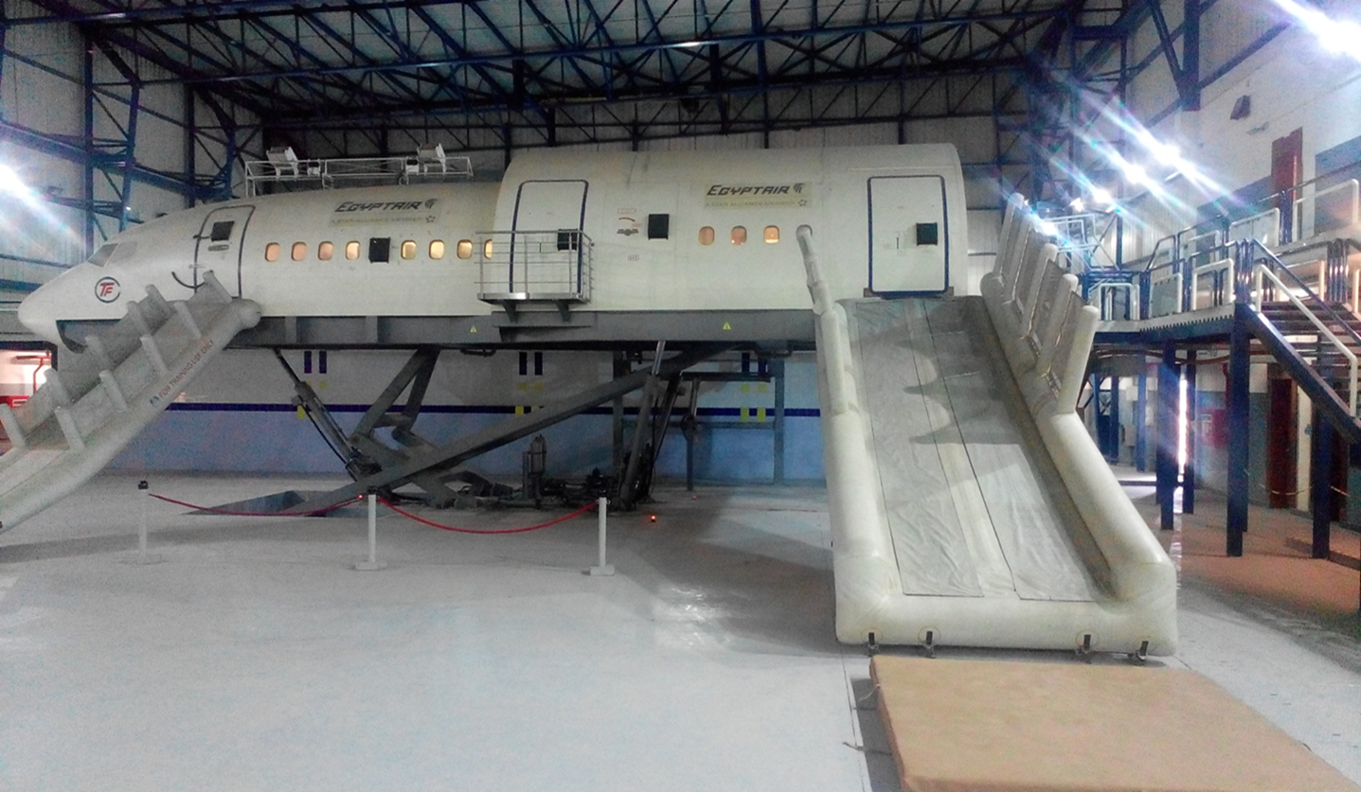
CEET Designed for training :-
- Wide cabin similar to A340 & B777 Aircraft types.
- Narrow cabin similar to A320 & B737 Aircraft types.

Slide 12
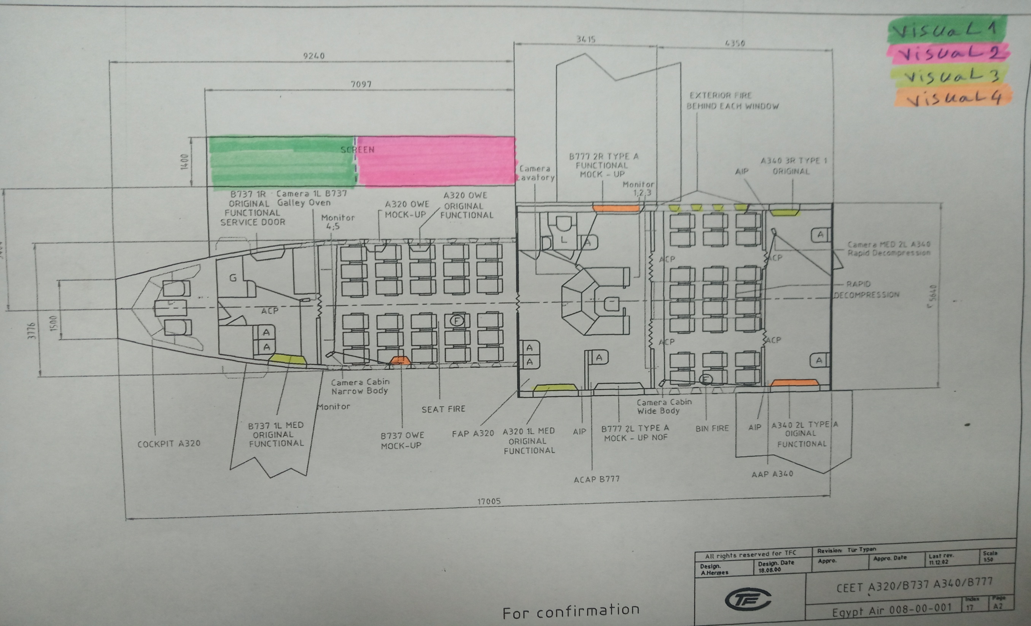

Slide 13
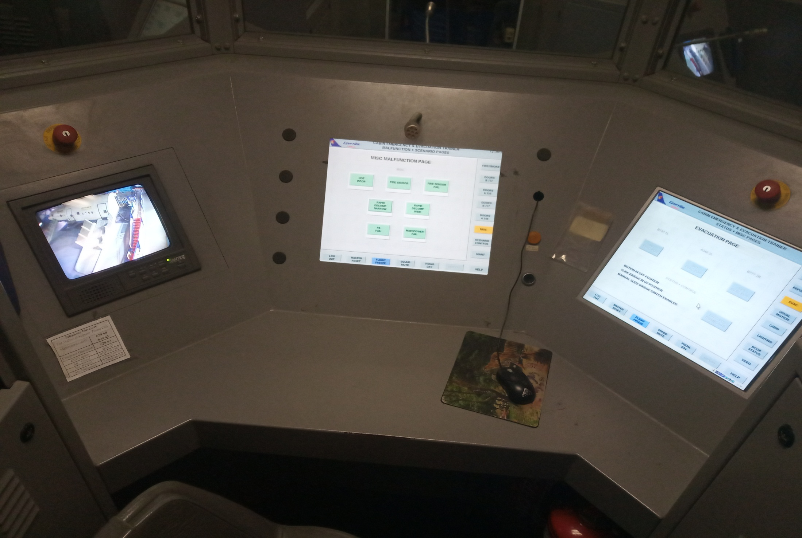
IOS (Instructor Operation station)

Slide 14
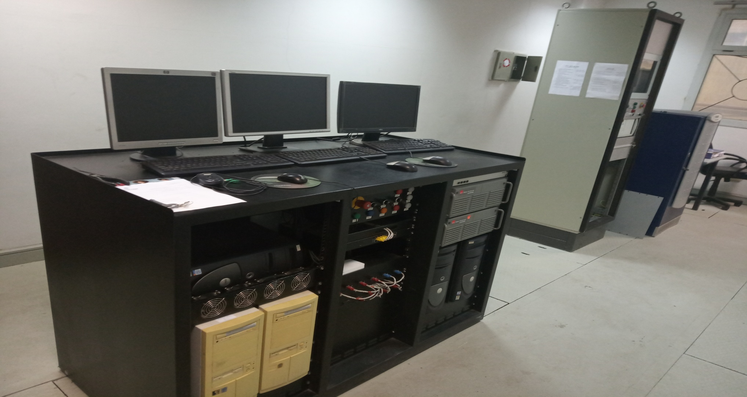
Computer Room

Slide 15
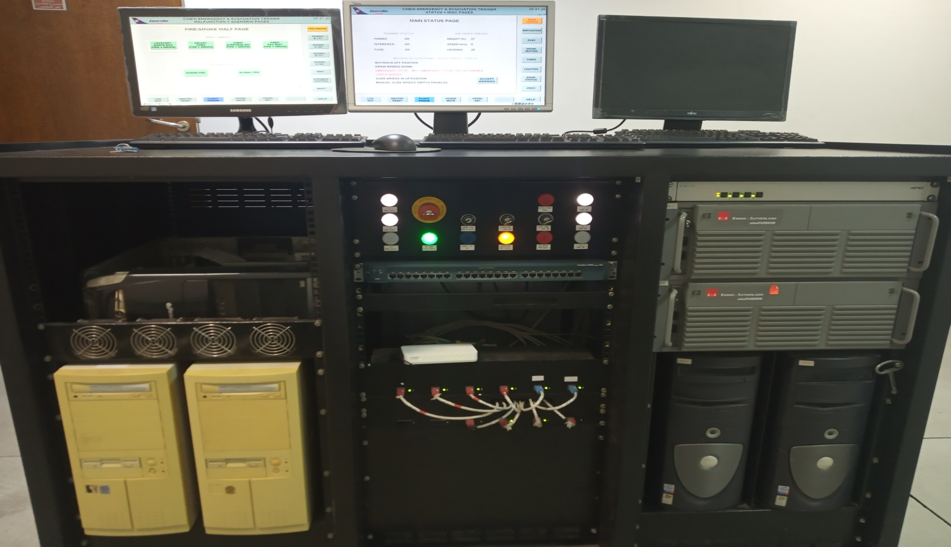
Computer Cabinet

Slide 16
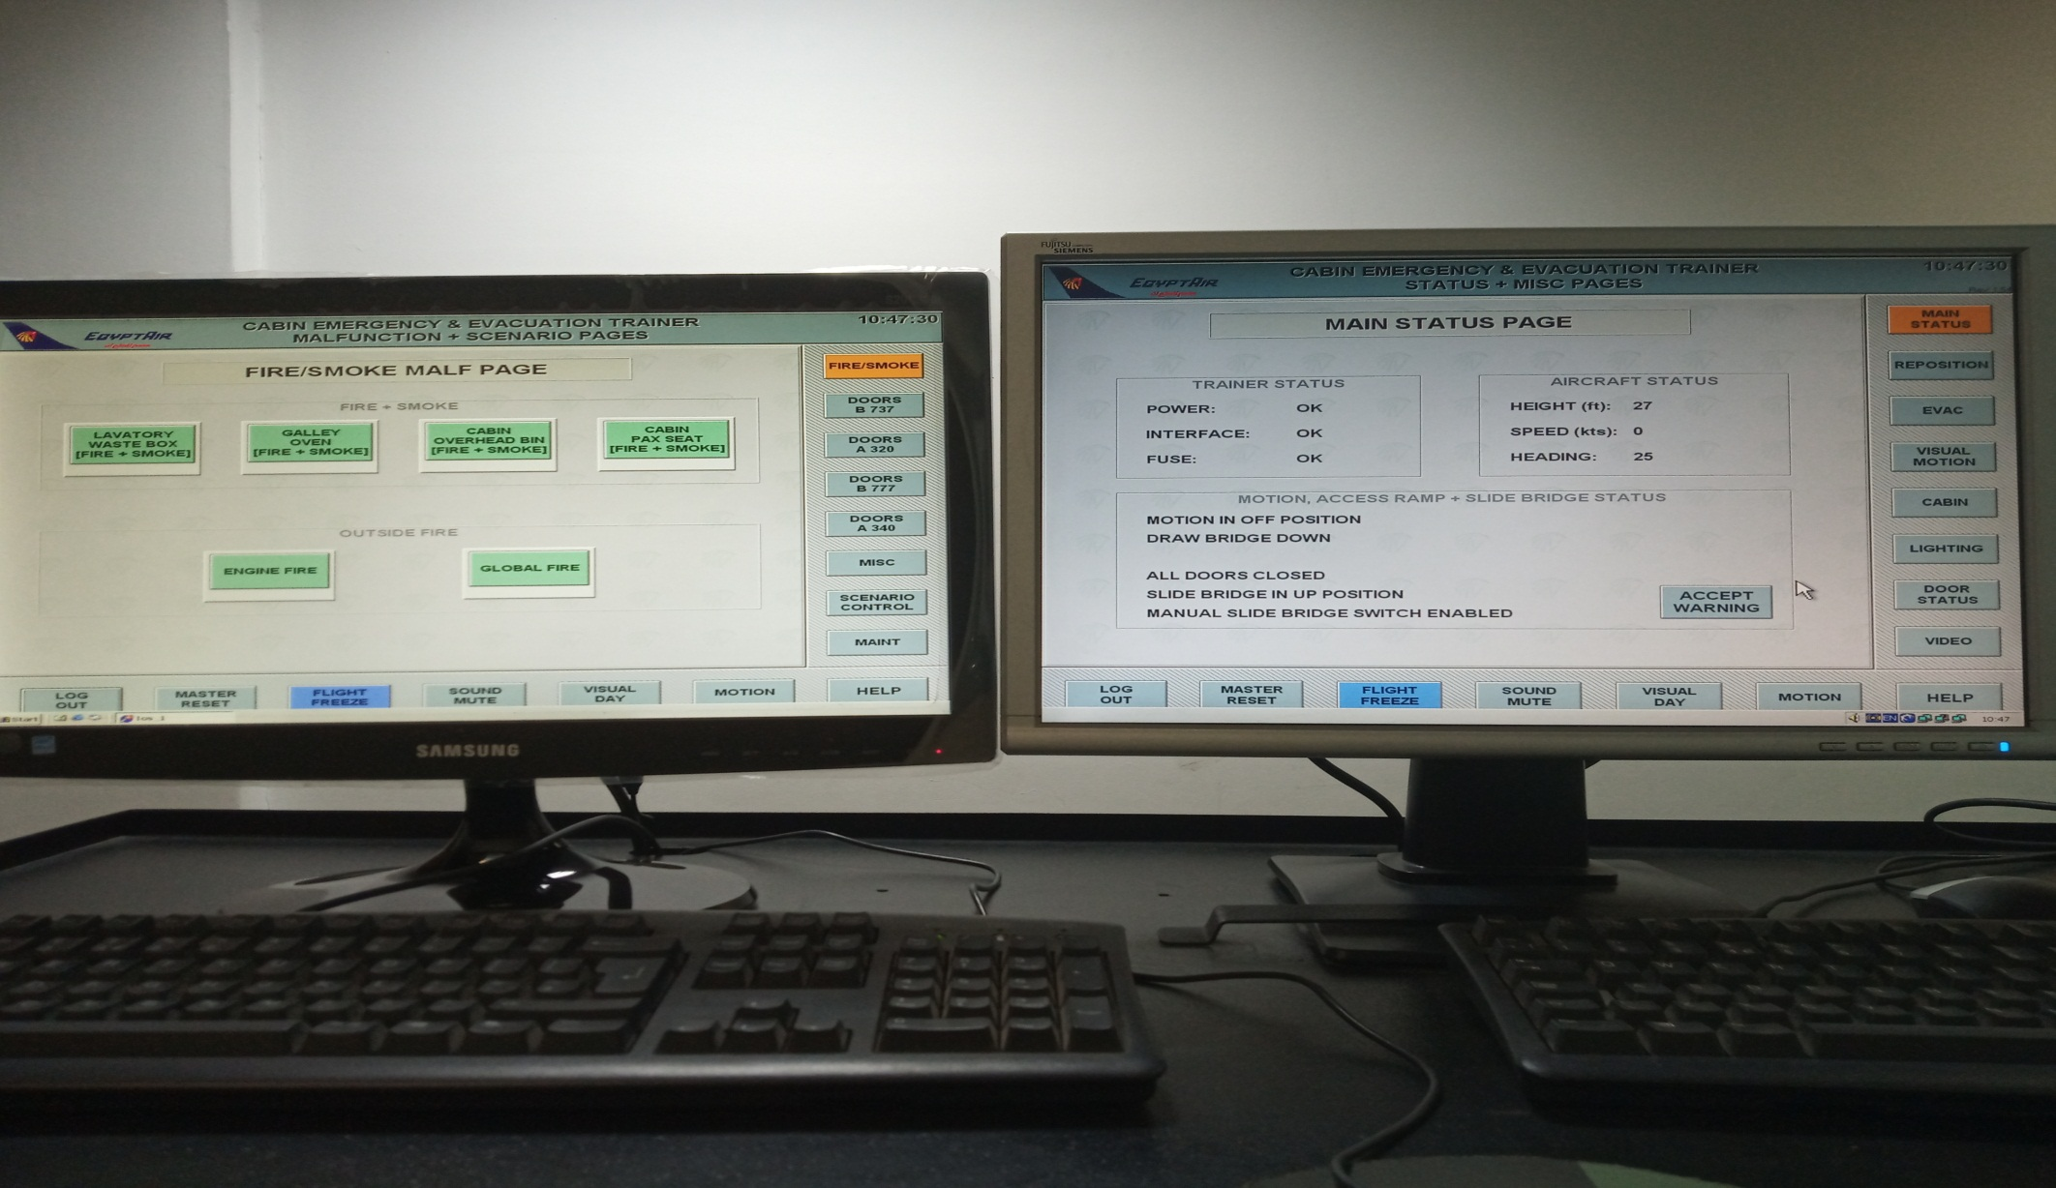
Host computer display

Slide 17
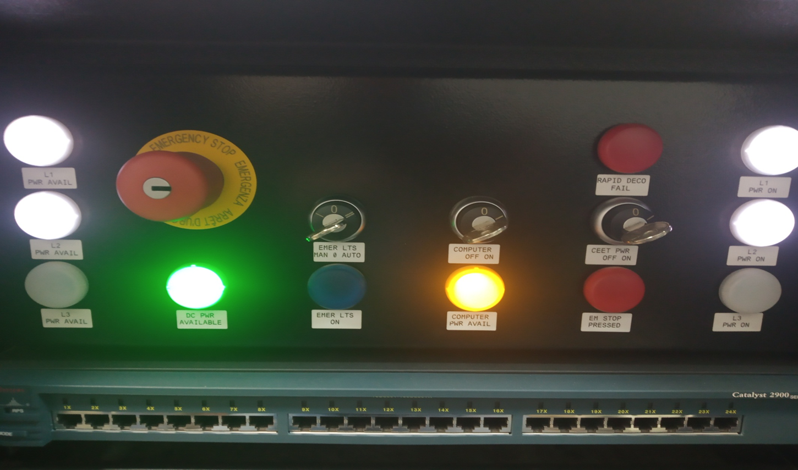
Computer Control Panel

Slide 18
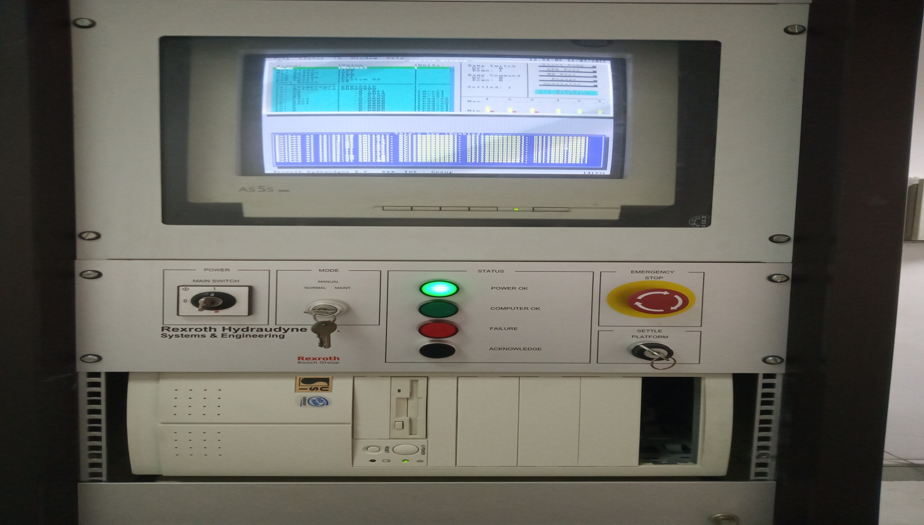
Motion cabinet

Slide 19
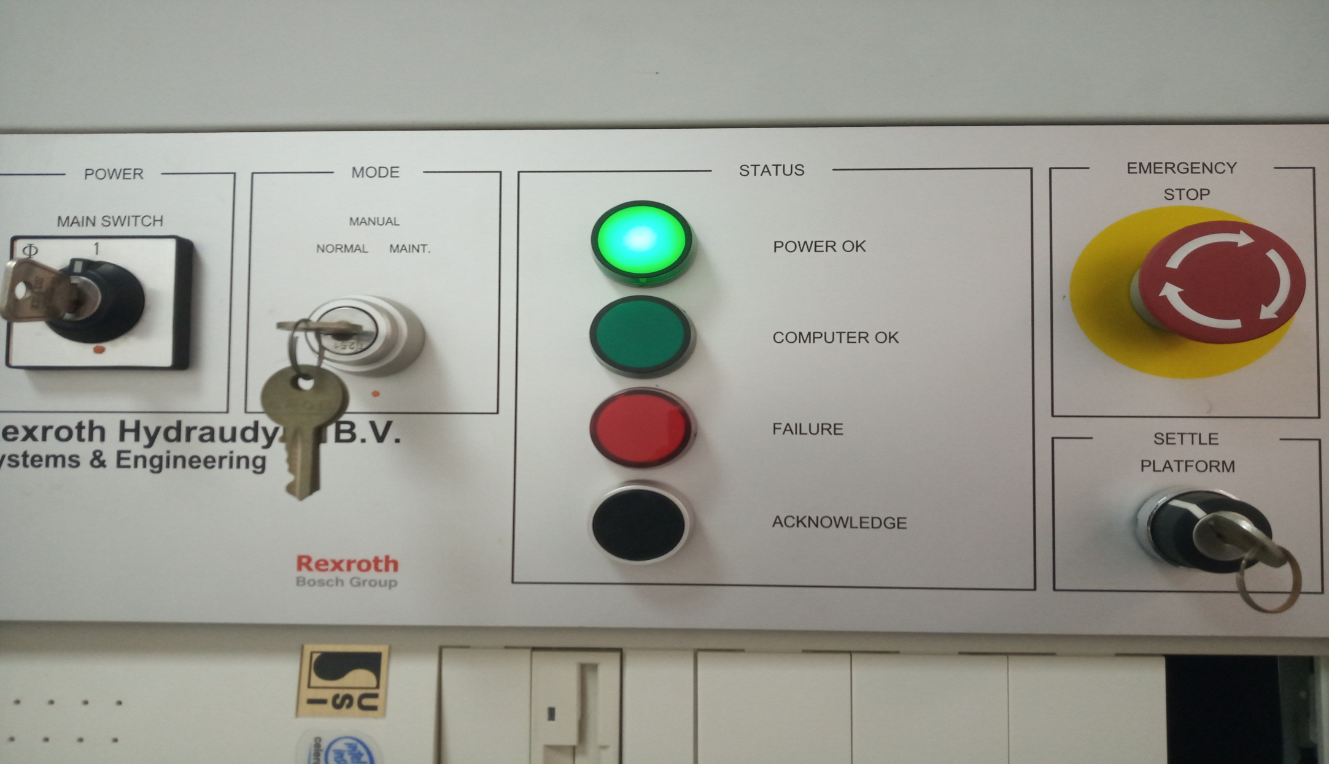
Motion Control Panel

Slide 20
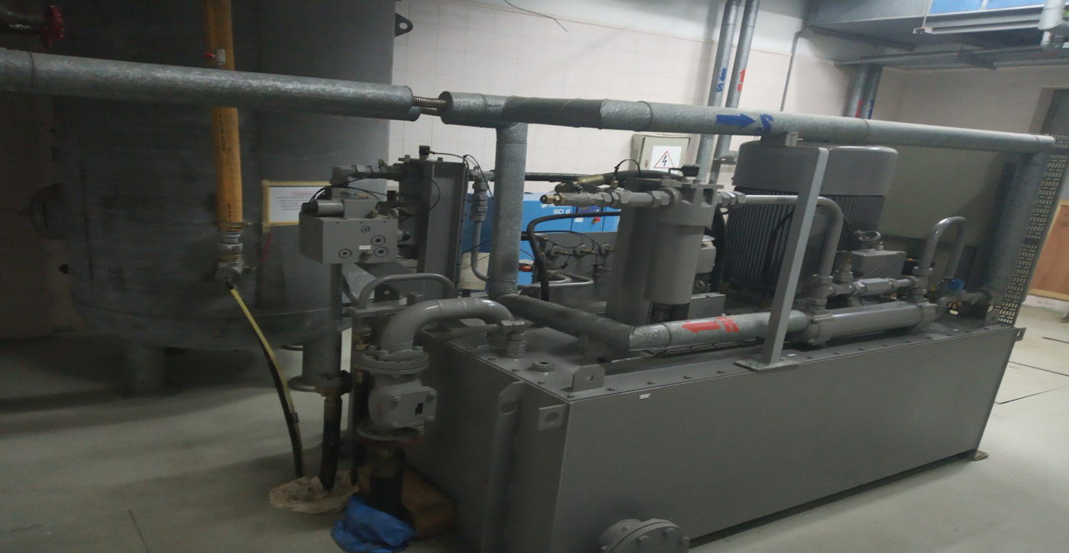
Motion Room

Slide 21
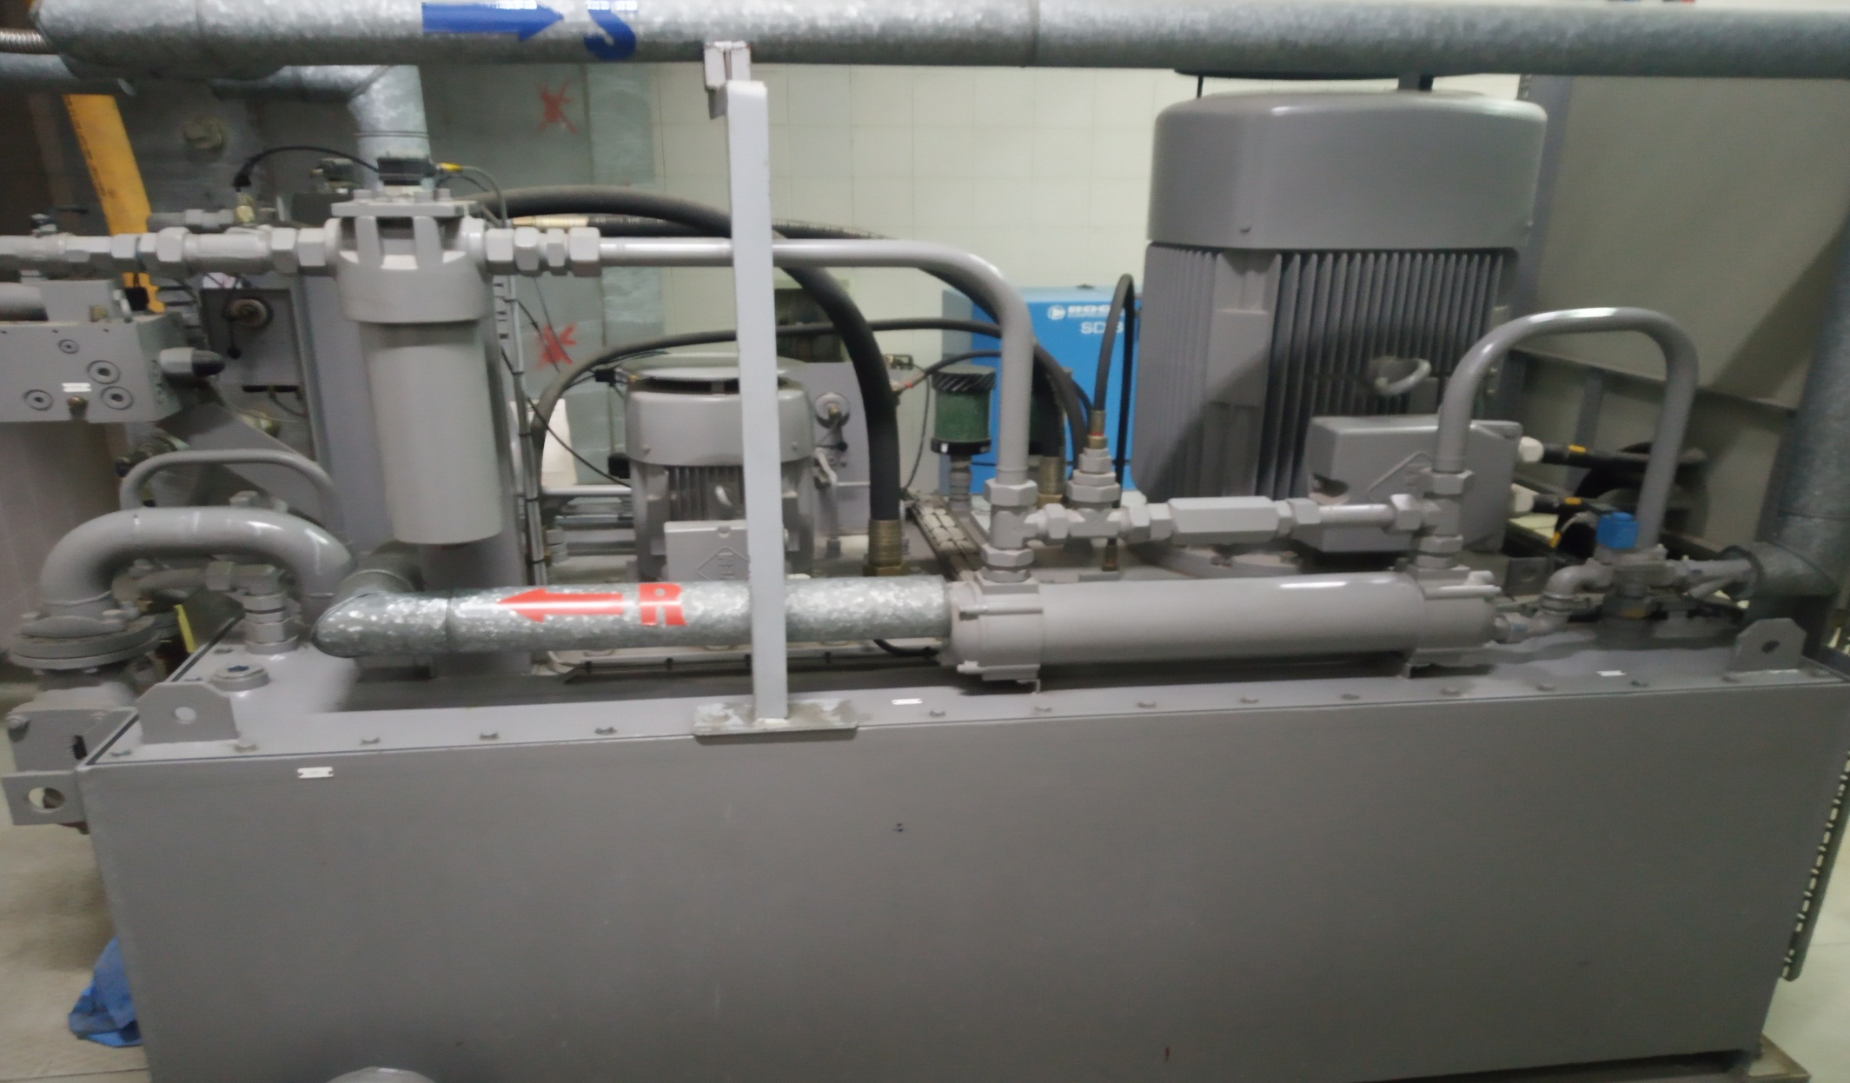
HPU (Hydraulic Power Unit)

Slide 22
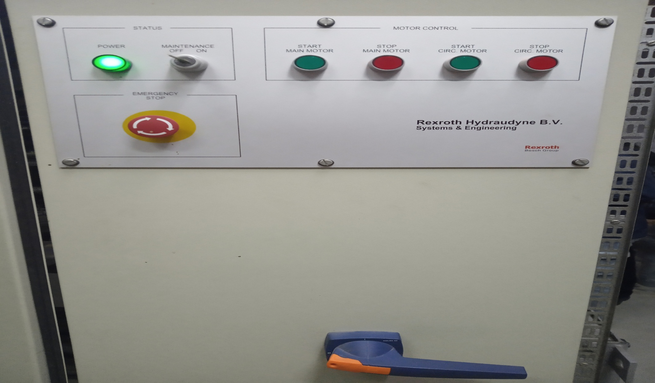
HPU Control Panel

Slide 23
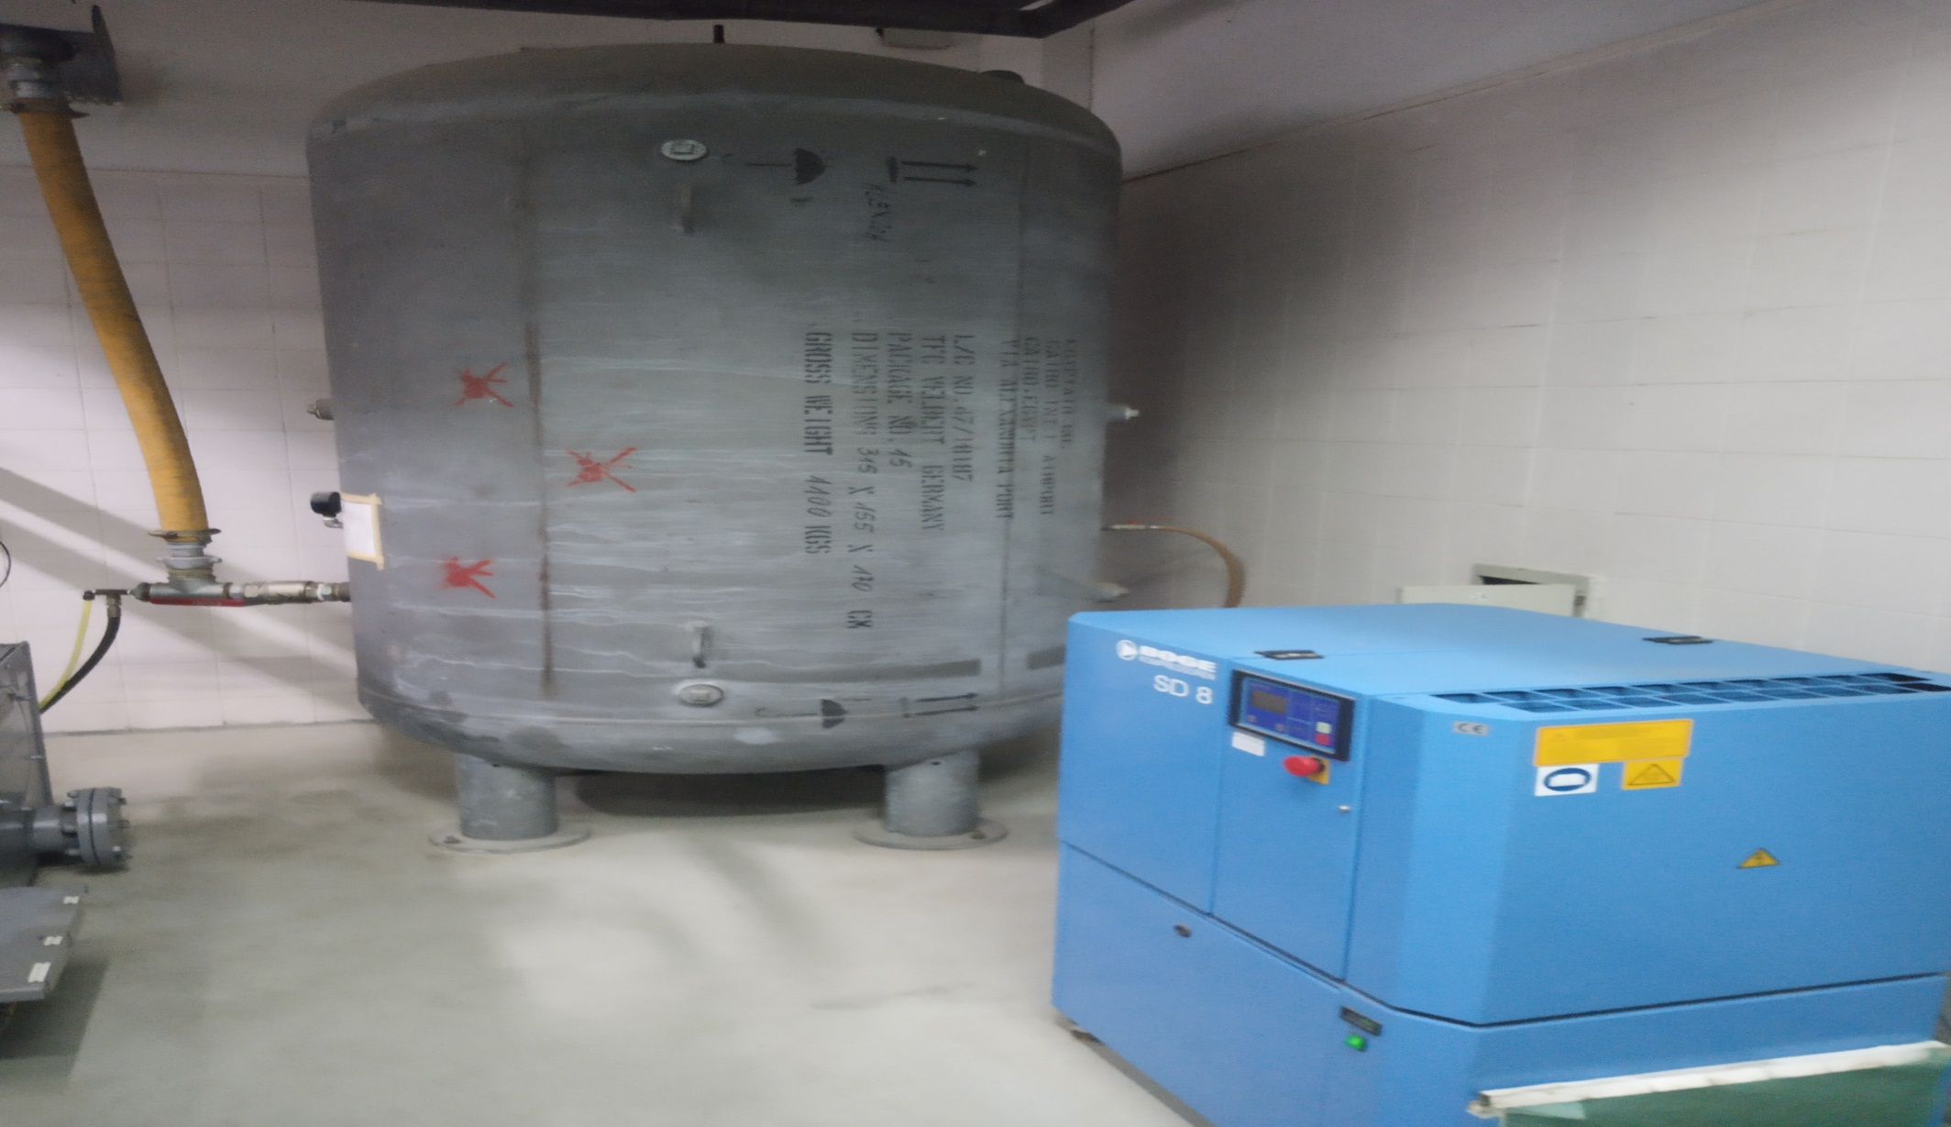
Pneumatic system

Slide 24
References : TFC Cabin simulator Manufacture .
Thank You
?
Please Feel free to Ask
Practical

